Slide 1
Refining methods for quantifying and interpreting the potential impact of unmeasured confounding
Lucy D’Agostino McGowan
Robert Greevy, Jr

Slide 2
✌️ parts
Discuss how to examine the measured confounders
Use this to inform how we think about unmeasured confounders
Health Policy Takeout Thursday

Slide 3
disclaimer
I am assuming you need some help figuring out the prevalence and magnitude of an unmeasured confounder
If you have an unmeasured confounder that you may be missing in mind, use that!
Health Policy Takeout Thursday

Slide 4
Meaningful confounders
1. How imbalanced is the unmeasured confounder between the exposure groups?
2. How predictive is the unmeasured confounder of the outcome?
3. How independent is the unmeasured confounder from the other covariates?
Health Policy Takeout Thursday

Slide 5

Observational Studies
Goal: Answer a research question
exposure
outcome
Health Policy Takeout Thursday

Slide 6
Outline
Observational study setup
Motivating example
Examine measured confounders
Tipping point sensitivity analyses
Health Policy Takeout Thursday

Slide 7
Outline
Observational study setup
Motivating example
Examine measured confounders
Tipping point sensitivity analyses
Health Policy Takeout Thursday

Slide 8
Observational Studies
“Gold Standard” – Randomized Controlled Trials
Treatment
P=0.5
Control
P=0.5
Health Policy Takeout Thursday

Slide 9
Observational Studies
Treatment
P=0.9
Control
P=0.1
Health Policy Takeout Thursday

Slide 10
Propensity scores
Rosenbaum and Rubin showed in observational studies, conditioning on propensity scores can lead to unbiased estimates of the treatment effect
There are no unmeasured confounders
Every subject has a nonzero probability of receiving either treatment
Health Policy Takeout Thursday

Slide 11
Propensity scores
Rosenbaum and Rubin showed in observational studies, conditioning on propensity scores can lead to unbiased estimates of the treatment effect
There are no unmeasured confounders
Every subject has a nonzero probability of receiving either treatment
Health Policy Takeout Thursday

Slide 12
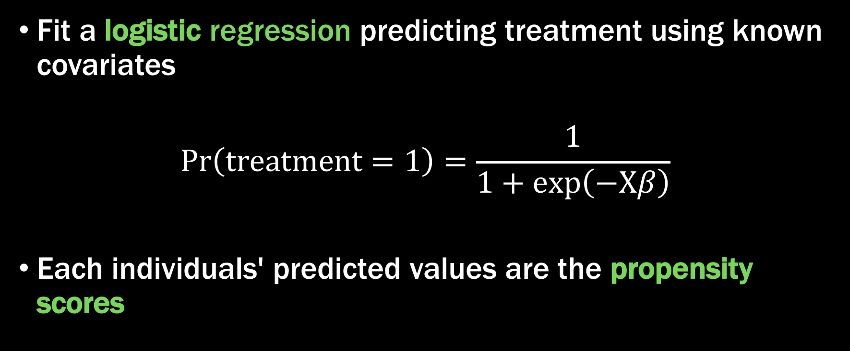
Propensity scores
Fit a logistic regression predicting treatment using known covariates
$$Pr\left(treatment=1\right)=\frac{1}{1+exp\left(−Xβ\right)}$$
Each individuals' predicted values are the propensity scores
Health Policy Takeout Thursday

Slide 13
Propensity scores
Health Policy Takeout Thursday

Slide 14
Propensity Scores
Propensity scores
Health Policy Takeout Thursday

Slide 15

Propensity scores
Health Policy Takeout Thursday

Slide 16
Meaningful confounders
1. How imbalanced is the unmeasured confounder between the exposure groups?
2. How predictive is the unmeasured confounder of the outcome?
3. How independent is the unmeasured confounder from the other covariates?
Health Policy Takeout Thursday

Slide 17
Imbalance between exposures
0.9
0.2
0.1
0.3
0.7
0.3
0.1
0.6
0.6
0.9
0.2
0.2
0.3
0.1
0.1
0.8
0.7
0.7
0.8
0.2
0.2
Health Policy Takeout Thursday

Slide 18
Imbalance between exposures
0.9
0.2
0.1
0.3
0.6
0.6
0.9
0.2
0.3
0.1
0.8
0.7
0.7
0.8
0.2
0.2
Health Policy Takeout Thursday

Slide 19
Imbalance between exposures
0.2
0.2
0.3
0.6
0.7
0.8
0.9
0.1
0.1
0.2
0.2
0.3
0.6
0.7
0.8
0.9
Health Policy Takeout Thursday

Slide 20
Imbalance between exposures
0.2
0.2
0.3
0.6
0.7
0.8
0.9
0.1
0.1
0.2
0.2
0.3
0.6
0.7
0.8
0.9
Health Policy Takeout Thursday

Slide 21
Imbalance between exposures
0.2
0.2
0.3
0.6
0.7
0.8
0.9
0.1
0.1
0.2
0.2
0.3
0.6
0.7
0.8
0.9
Health Policy Takeout Thursday

Slide 22
Propensity Scores
Imbalance between exposures
0.2
0.2
0.3
0.6
0.7
0.8
0.9
0.1
0.1
0.2
0.2
0.3
0.6
0.7
0.8
0.9
Health Policy Takeout Thursday

Slide 23
Propensity scores
0.1
0.2
0.2
0.3
0.6
0.7
0.8
0.9
0.1
0.2
0.2
0.3
0.6
0.7
0.8
0.9
0.1
0.2
0.2
0.3
0.6
0.7
0.8
0.9
0.1
0.2
0.2
0.3
0.6
0.7
0.8
0.9
0.1
0.2
0.2
0.3
0.6
0.7
0.8
0.9
0.1
0.2
0.2
0.3
0.6
0.7
0.8
0.9
0.1
0.2
0.2
0.3
0.6
0.7
0.8
0.9
0.1
0.2
0.2
0.3
0.6
0.7
0.8
0.9
Health Policy Takeout Thursday

Slide 24
0.1
0.2
0.2
0.3
0.6
0.7
0.8
0.9
0.1
0.2
0.2
0.3
0.6
0.7
0.8
0.9
0.1
0.2
0.2
0.3
0.6
0.7
0.8
0.9
0.1
0.2
0.2
0.3
0.6
0.7
0.8
0.9
0.1
0.2
0.2
0.3
0.6
0.7
0.8
0.9
0.1
0.2
0.2
0.3
0.6
0.7
0.8
0.9
0.1
0.2
0.2
0.3
0.6
0.7
0.8
0.9
0.1
0.2
0.2
0.3
0.6
0.7
0.8
0.9
0.1
0.2
0.2
0.3
0.6
0.7
0.8
0.9
0.1
0.2
0.2
0.3
0.6
0.7
0.8
0.9
0.1
0.2
0.2
0.3
0.6
0.7
0.8
0.9
0.1
0.2
0.2
0.3
0.6
0.7
0.8
0.9
0.1
0.2
0.2
0.3
0.6
0.7
0.8
0.9
0.1
0.2
0.2
0.3
0.6
0.7
0.8
0.9
0.1
0.2
0.2
0.3
0.6
0.7
0.8
0.9
0.1
0.2
0.2
0.3
0.6
0.7
0.8
0.9
0.1
0.2
0.2
0.3
0.6
0.7
0.8
0.9
0.1
0.2
0.2
0.3
0.6
0.7
0.8
0.9
0.1
0.2
0.2
0.3
0.6
0.7
0.8
0.9
0.1
0.2
0.2
0.3
0.6
0.7
0.1
0.2
0.2
0.3
0.6
0.7
0.8
0.9
0.1
0.2
0.2
0.3
0.6
0.7
0.8
0.9
0.1
0.2
0.2
0.3
0.6
0.7
0.8
0.9
Health Policy Takeout Thursday

Slide 25
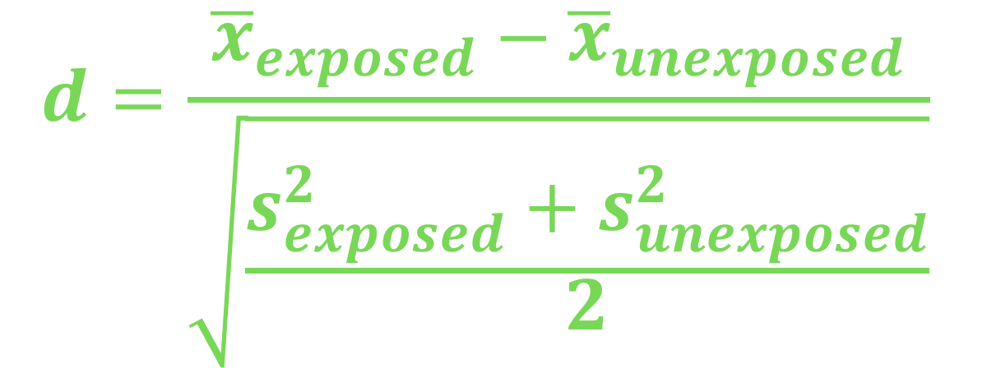
Love plots
$$d=\frac{{\overline{x}}_{exposed}−{\overline{x}}_{unexposed}}{\sqrt{\frac{s_{exposed}^{2}+s_{unexposed}^{2}}{2}}}$$
Health Policy Takeout Thursday

Slide 26
Imbalance between exposures
Love Plots
Health Policy Takeout Thursday

Slide 27
Propensity scores
Health Policy Takeout Thursday

Slide 28
Imbalance between exposures
Love Plots
Health Policy Takeout Thursday

Slide 29
Imbalance between exposures
0.2
0.2
0.3
0.6
0.7
0.8
0.9
0.1
0.1
0.2
0.2
0.3
0.6
0.7
0.8
0.9
Health Policy Takeout Thursday

Slide 30
Imbalance between exposures
Love Plots
Health Policy Takeout Thursday

Slide 31
Meaningful confounders
1. How imbalanced is the unmeasured confounder between the exposure groups?
2. How predictive is the unmeasured confounder of the outcome?
3. How independent is the unmeasured confounder from the other covariates?
Health Policy Takeout Thursday

Slide 32
Observed bias plot
Health Policy Takeout Thursday

Slide 33
unmeasured confounding
Health Policy Takeout Thursday

Slide 34
Quantify unmeasured confounding
review of 90 observational studies 2015
45.6% mentioned unmeasured confounding as a limitation
4.4% included a quantitative sensitivity analysis ☹️
Health Policy Takeout Thursday

Slide 35
Quantify unmeasured confounding
Lin, Psaty, & Kronmal
Rosenbaum & Rubin
Schlesselman
Cornfield
Health Policy Takeout Thursday

Slide 36
All you need
Exposure-outcome effect
Exposure-unmeasured confounder effect
Outcome-unmeasured confounder effect
Health Policy Takeout Thursday

Slide 37
All you need
Exposure-outcome effect generally estimated from a model, for example an odds ratio, hazard ratio, or risk ratio
Exposure-unmeasured confounder effect
Outcome-unmeasured confounder effect
Health Policy Takeout Thursday

Slide 38
All you need
Exposure-outcome effect generally estimated from a model, for example an odds ratio, hazard ratio, or risk ratio
Exposure-unmeasured confounder effect
Outcome-unmeasured confounder effect
Health Policy Takeout Thursday

Slide 39
All you need
Exposure-outcome effect generally estimated from a model, for example an odds ratio, hazard ratio, or risk ratio
Exposure-unmeasured confounder effect
Outcome-unmeasured confounder effect
Health Policy Takeout Thursday

Slide 40
All you need
Exposure-outcome effect generally estimated from a model, for example an odds ratio, hazard ratio, or risk ratio
Exposure-unmeasured confounder effect
Outcome-unmeasured confounder effect
Health Policy Takeout Thursday

Slide 41

Tipping point analyses
what will tip our confidence bound to cross 1
Health Policy Takeout Thursday

Slide 42

Tipping point analysis
$$Γ\left(LB_{obs}, p_{0}, p_{1}\right)=\frac{\left(1−p_{1}\right)+LB_{obs}(p_{0}−1) }{LB_{obs}p_{0}−p_{1}}$$
Health Policy Takeout Thursday

Slide 43
1.5
Observed bias plot
Health Policy Takeout Thursday

Slide 44

Tipping point analysis
$$Γ\left(LB_{obs}, p_{0}, p_{1}\right)=\frac{\left(1−p_{1}\right)+1.5(p_{0}−1) }{1.5p_{0}−p_{1}}$$
Health Policy Takeout Thursday

Slide 45
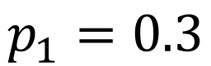
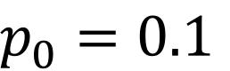
Imbalance between exposures
$p_{0}=0.1$
$$p_{1}=0.3$$
Love Plots
Health Policy Takeout Thursday

Slide 46

Tipping point analysis
$$Γ\left(LB_{obs}, p_{0}, p_{1}\right)=\frac{\left(1−0.3\right)+1.5(0.1−1) }{1.5(0.1)−0.3}$$
Health Policy Takeout Thursday

Slide 47

Tipping point analysis
$$4.33=\frac{\left(1−0.3\right)+1.5(0.1−1) }{1.5(0.1)−0.3}$$
Health Policy Takeout Thursday

Slide 48
“
A hypothetical unobserved binary confounder that is prevalent in 30% of the exposed population and 10% of the unexposed population would need to have an association with Y of 4.33 to tip this analysis at the 5% level, rendering it inconclusive.
”
Health Policy Takeout Thursday

Slide 49
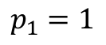
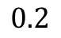
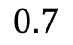
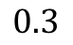
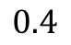
$$0.2$$
prevalence in exposed: 30%
prevalence in unexposed: 10%
outcome association: 4.33
$$0.3$$
$$0.4$$
$$0.7$$
$$p_{1}=1$$
Health Policy Takeout Thursday

Slide 50
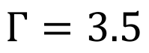
$$Γ=3.5$$
Observed bias plot
Health Policy Takeout Thursday

Slide 51

Tipping point analysis
$$p_{0}\left(LB_{obs},Γ, p_{1}\right)=\frac{p_{1}\left(Γ−1\right)+1−LB_{obs}}{{LB}_{obs}(Γ−1)}$$
Health Policy Takeout Thursday

Slide 52

Tipping point analysis
$$p_{0}\left(LB_{obs},Γ, p_{1}\right)=\frac{p_{1}\left(3.5−1\right)+1−1.5}{1.5(3.5−1)}$$
Health Policy Takeout Thursday

Slide 53

Tipping point analysis
$$p_{0}\left(LB_{obs},Γ, p_{1}\right)=\frac{0.2\left(3.5−1\right)+1−1.5}{1.5(3.5−1)}$$
Health Policy Takeout Thursday

Slide 54

Tipping point analysis
$$0=\frac{0.2\left(3.5−1\right)+1−1.5}{1.5(3.5−1)}$$
Health Policy Takeout Thursday

Slide 55
$$0.2$$
prevalence in exposed: 20%
prevalence in unexposed: 0%
outcome association: 3.5
$$0.3$$
$$0.4$$
$$0.7$$
$$p_{1}=1$$
Health Policy Takeout Thursday

Slide 56
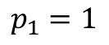
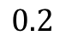
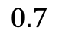
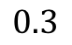
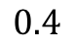

$$0.2$$
$$∞$$
$$0.3$$
$$0.4$$
$$0.7$$
$$p_{1}=1$$
Health Policy Takeout Thursday

Slide 57
Tipping point analysis
$$p_{0}\left(LB_{obs},Γ, p_{1}\right)=\frac{p_{1}\left(3.5−1\right)+1−1.5}{1.5(3.5−1)}$$
Health Policy Takeout Thursday

Slide 58

Tipping point analysis
$$0.53=\frac{\left(3.5−1\right)+1−1.5}{1.5(3.5−1)}$$
Health Policy Takeout Thursday

Slide 59
$$0.2$$
prevalence in exposed: 100%
prevalence in unexposed: 53%
outcome association: 3.5
$$0.3$$
$$0.4$$
$$0.7$$
$$p_{1}=1$$
Health Policy Takeout Thursday

Slide 60
$$0.2$$
prevalence in exposed: 100%
prevalence in unexposed: 42%
outcome association: 2.37
$$0.3$$
$$0.4$$
$$0.7$$
$$p_{1}=1$$
E-value
Health Policy Takeout Thursday

Slide 61
conclusion
we have presented a useful, easily implemented, and intuitively understood approach to allow researchers to assess the potential impact of unmeasured confounders in observational research
can be applied to both past and future research, allowing readers to understand the sensitivity of studies that do not include such an analysis, and allowing future investigators to readily include such an analysis
Health Policy Takeout Thursday

Slide 62
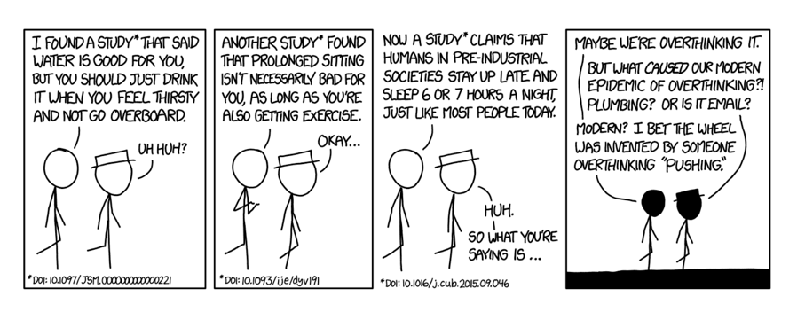
https://xkcd.com/1592
On the other hand, it took us embarrassingly long to clue in to the lung cancer/cigarette thing, so I guess the real lesson is "figuring out which ideas are true is hard."
Health Policy Takeout Thursday

Slide 63
References
Cornfield, J., Haenszel, W., Hammond, E. C., Lilienfeld, A. M., Shimkin, M. B., & Wynder, E. L. (2009). Smoking and lung cancer: recent evidence and a discussion of some questions. 1959. International journal of epidemiology (Vol. 38, pp. 1175–1191). Oxford University Press. http://doi.org/10.1093/ije/dyp289
Schlesselman, J. J. (1978). Assessing effects of confounding variables. American Journal of Epidemiology, 108(1), 3–8.
Rosenbaum, P. R., & Rubin, D. B. (1983). The Central Role of the Propensity Score in Observational Studies for Causal Effects. Biometrika, 70(1), 41. http://doi.org/10.2307/2335942
Lin, D. Y., Psaty, B. M., & Kronmal, R. A. (1998). Assessing the sensitivity of regression results to unmeasured confounders in observational studies. Biometrics, 54(3), 948–963.
VanderWeele, T. J., & Ding, P. (2017). Sensitivity Analysis in Observational Research: Introducing the E-Value. Ann Intern Med, 167(4), 268–274. http://doi.org/10.7326/M16-2607
Health Policy Takeout Thursday

Slide 64


Contact
@LucyStats
ld.mcgowan@vanderbilt.edu
lucymcgowan.com
Health Policy Takeout Thursday

